Slide 1
Advanced Deep Learning ZG513
Prepared by Dr. Sugata Ghosal & edited by Aakash Goel

Slide 2
Lecture overview
Likelihood Based Models
Simple generative models: histograms
Parameterized distributions and maximum likelihood
Autoregressive Models
Recurrent Neural Nets
Masking-based Models
Notes:
We will learn models that explicitly assign probabilities to data.
A likelihood-based model is like a quality inspector that can score any sample.
These models try to answer a very simple question: How likely is this data point? Instead of just learning features, we now try to learn the full data distribution

Slide 3
Likelihood-based models
Problems we’d like to solve:
Generating data: synthesizing images, videos, speech, text
Compressing data: constructing efficient codes
Anomaly detection
Likelihood-based models
Estimate p_{data} from samples x⁽¹⁾, …, x^{(n)} ~ p_{data}(x)
Learns a distribution p that allows:
Computing p(x) for arbitrary x
Sampling x ~ p(x)
Notes:
Why do we even care about modeling probability distributions If I truly understand how data is distributed, I should be able to generate new data that looks real Examples:
Generate images
Generate speech
Generate text (next word prediction)
Sampling from a distribution is generation If something is very likely, I should store it using fewer bits Common patterns → short codes
Rare patterns → longer codes
This is why probability and compression are mathematically connected If a model assigns very low probability to a data point, we can call it abnormal Example:
Fault detection in sensors
Defective images in manufacturing
A likelihood-based model explicitly learns a probability distribution over data
We are given samples: $$x^{\left(1\right)},x^{\left(2\right)},…,x^{\left(n\right)}$$
These come from an unknown true distribution $p_{\text{data}}\left(x\right)$
Our goal:
“Learn a model distribution $p\left(x\right)$that behaves like the real one.”
What must the model allow us to do?
A good likelihood model must allow:
Compute probability
“Given any input $x$, I should be able to compute $p\left(x\right)$.”
Generate data
“I should be able to sample new $x$’s from the model.”
“If a model can’t do both, it’s not a proper generative model.”
We only see samples; we want to learn the unknown data distribution
A likelihood-based generative model learns what ‘normal’ data looks like by learning a probability score for every possible example
Imagine a factory quality inspector. For every part coming on the line, the inspector gives a score:
“This looks normal: high score”
“This looks suspicious: low score”
What are we trying to build?
A model that becomes this inspector.
Input: any data sample $x$(image, sensor vector, log sequence)
Output: a normality score → probability (likelihood)
Why do we care?
Because if you can score “how normal” something is, you can do three huge things:
Anomaly detection: low score = potential fault
Generation: if you know what “normal” is, you can produce normal samples
Compression: normal patterns can be encoded shorter (more predictable)
We want a model that can look at any sample and say: ‘How normal is this?’ If it’s normal, probability is high. If it’s weird, probability is low
If I can score normality, I can detect anomalies, generate new examples, and compress data.”

Slide 4
Desiderata
We want to estimate distributions of complex, high-dimensional data
A 128×128×3 image lies in a ~50,000-dimensional space
We also want computational and statistical efficiency
Efficient training and model representation
Expressiveness and generalization
Sampling quality and speed
Compression rate and speed
Notes:
High dimensionality
“A single 128×128 RGB image lives in a 50,000-dimensional space.”
“How many examples would I need to cover that space by brute force?”
Answer:
“Astronomical. Impossible.”
Efficiency requirements
Even if I had the data, I still want:
Fast training
Compact model
Good generalization
Fast sampling
Good compression
“This is the tension: expressive but efficient.”
The City Map vs The Phone GPS” (Explains histogram → curse → parameterization)
Step A: Histogram = drawing a detailed map by hand
Suppose you want a map of a city. You start by dividing the city into small squares (bins) and writing down:
“How many people visited each square?”
That’s a histogram: count visits per square.
Step B: Works in small cities (1D)
If your “city” is just a road (1D), this is easy.
Step C: Fails in big cities (high dimension)
Now imagine the city is 50,000-dimensional (like an image: 128×128×3).
Your “grid” becomes astronomical. Most squares have zero visits. So the map is useless.
✅ Simple conclusion:
“Counting works only when the world is small. High-dimensional worlds are too big to count.”
Step D: Parameterized distribution = GPS model
Instead of mapping every square manually, you use a smaller model:
“Traffic behaves like these patterns (few parameters)”
“Roads are connected, flows are smooth”
That’s parameterization: use structure instead of brute-force counting.
✅ Message:
“We move from memorization (counting) to structure (parametric models).”

Slide 5
Lecture overview
Motivation
Simple generative models: histograms
Parameterized distributions and maximum likelihood
Autoregressive Models
Recurrent Neural Nets
Masking-based Models

Slide 6
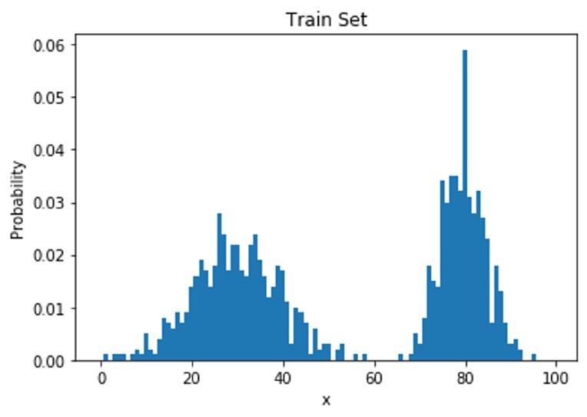
Learning: Estimate frequencies by counting
Recall: the goal is to estimate p_{data} from samples x⁽¹⁾, …, x^{(n)} ~ p_{data}(x)
Suppose the samples take on values in a finite set {1, …, k}
The model: a histogram
(Redundantly) described by k nonnegative numbers: p₁, …, p_{k}
To train this model: count frequencies p_{i} = (# times i appears in the dataset) /
(# points in the dataset)
How can we compute likelihoods and sample from this model?
Notes:
“Let’s start with the simplest possible generative model.”
Assumption
“Suppose data can take only a finite set of values: 1, 2, 3, …, k.”
Examples:
Dice rolls
Discrete symbols
Quantized pixels
The model
“We store one number per value: $p_{1},p_{2},…,p_{k}$”
These represent:
“The probability of seeing each value.”
Training = counting
Say:
“Training is just counting how often each value appears.”
$$p_{i}=\frac{\text{count} \text{of} i}{\text{total} \text{number} \text{of} \text{samples}}$$
Pause and emphasize:
“This is maximum likelihood estimation in its simplest form.”

Slide 7
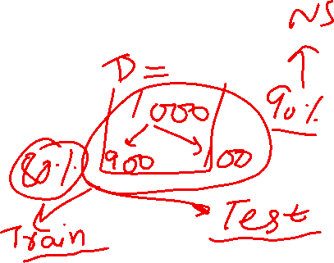
Inference and Sampling
Inference (querying p_{i} for arbitrary i): simply a lookup into the array p₁, …, p_{k}
Sampling (lookup into the inverse cumulative distribution function)
From the model probabilities p₁, …, p_{k}, compute the cumulative distribution
F_{i} = p₁ + ⋯ + p_{i} for all i ∈ {1, …, k}
Draw a uniform random number u ~ [0, 1]
Return the smallest i such that u ≤ F_{i}
Are we done?
Notes:
“If I want to know the probability of value $i$, I just look it up.”
$$p\left(x=i\right)=p_{i}$$
“Inference is O(1). Just an array lookup.”
Suppose our dataset is very simple
We observe values from the set:
$$\left\{1 , 2 , 3 , 4\right\}$$
And after counting frequencies from data, we get:
Value $i$CountProbability $p_{i}$1100.102200.203300.304400.40
Total samples = 100
What does inference mean?
“Inference means: given a value, what is its probability under the model?”
Sampling — how do we generate data?
Are we done? Explain why:
Histogram works only for:
Small discrete spaces
For images:
Too many bins
Most bins never seen
Zero probability problem
No generalization
“Counting memorizes — it doesn’t understand.
So histograms are a valid likelihood-based model, but completely impractical for real data. This is why we need parameterized distributions, autoregressive models, and neural networks — to generalize beyond counting

Slide 8
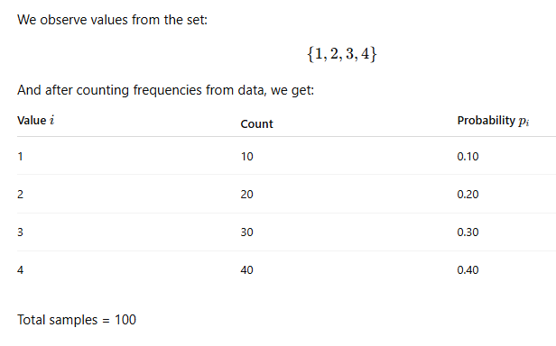
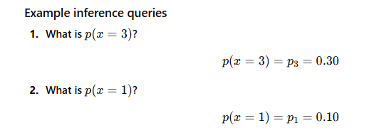
Inference and Sampling
Inference means: given a value, what is its probability under the model

Slide 9
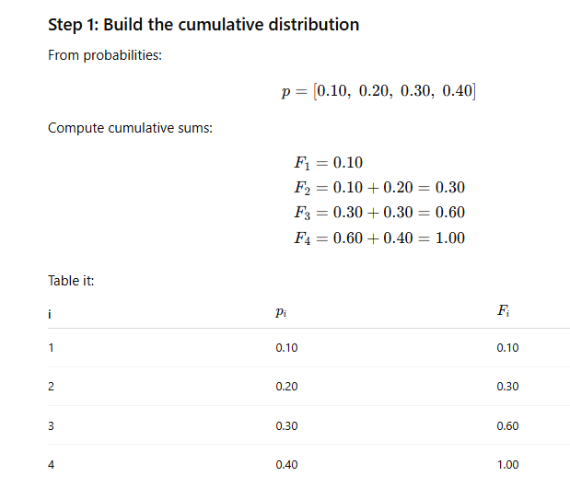
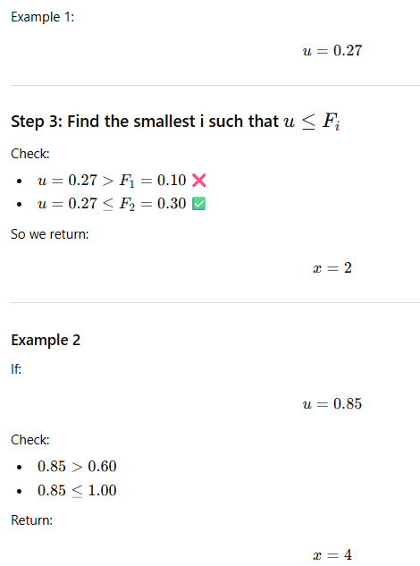
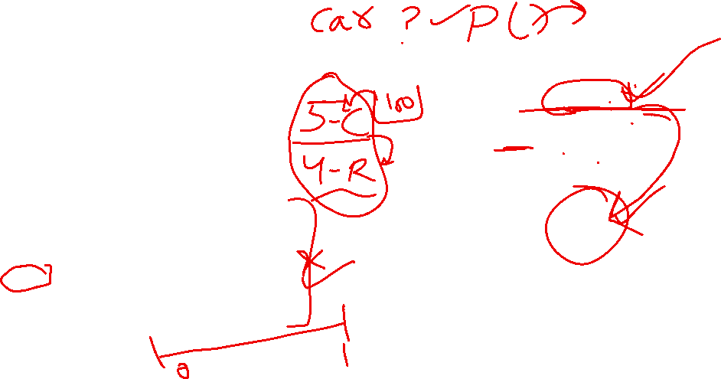
Generate Data
Now we generate a random number uniformly between 0 and 1.

Slide 10
Some Impt. concepts
Stratified Sampling
Law of Large Numbers – More data == More truth. If you do experiment many times, avg. of results will take you closer to true probability.
CLT (Central Limit Theorem): N – samples of data and each sample say have m points.. Avg of each sampled data (m points), distribution of avg. == Normal distribution.
Weights – NN start with random weights. Xavier or he initialization
SGD – random mini batch
Ensemble methods: confidence interval for predictions in Bagging
Hughes Law –
No of rows/data points
No of features/columns/dimensions
Too many features , too little data ➔ overfitting
A

Slide 11
Failure in high dimensions
No, because of the curse of dimensionality. Counting fails when there are too many bins.
(Binary) MNIST: 28x28 images, each pixel in {0, 1}
There are 2⁷⁸⁴ ≈ 10²³⁶ probabilities to estimate
Any reasonable training set covers only a tiny fraction of this
No generalization whatsoever! There is shared structure among images but this kind of model would not be able to capture that.

Slide 12
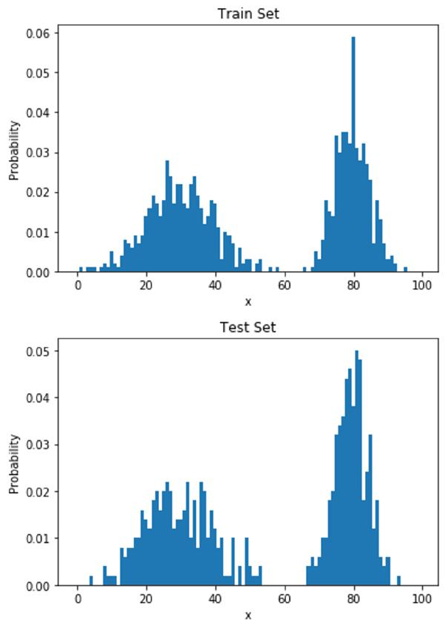
Problematic even for single variable
learned histogram = training data distribution
→ often poor generalization

Slide 13
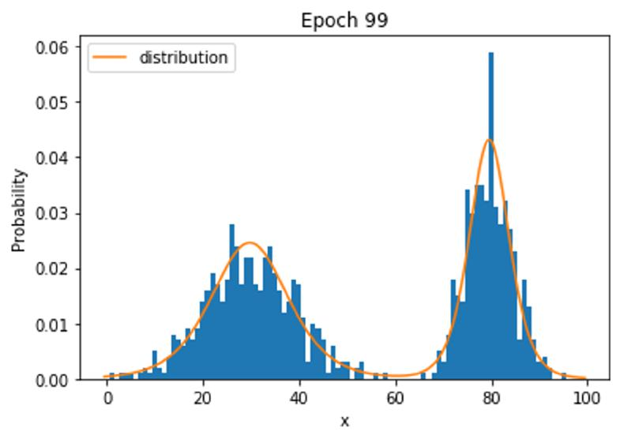
Parameterized Distributions
Fitting a parameterized distribution often generalizes better

Slide 14
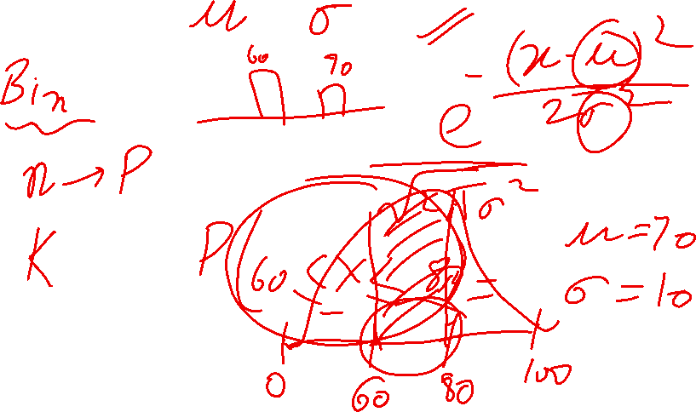

Slide 15
Lecture overview
Motivation
Simple generative models: histograms
Parameterized distributions and maximum likelihood
Autoregressive Models
Recurrent Neural Nets
Masking-based Models

Slide 16
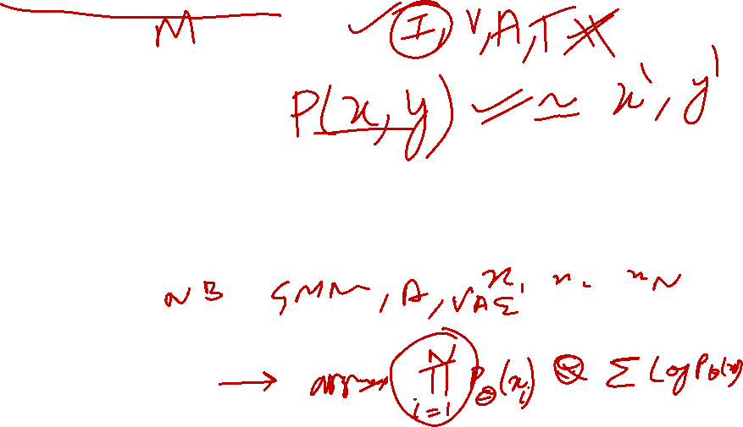
Likelihood-based generative models
Recall: the goal is to estimate p_{data} from x⁽¹⁾, …, x^{(n)} ~ p_{data}(x)
Now we introduce function approximation: learn θ so that p_{θ}(x) ≈ p_{data}(x).
How do we design easy-to-train function approximators to effectively represent complex joint distributions over x?
There will be many choices for model design, each with different tradeoffs and different compatibility criteria.
Designing the model and the training procedure go hand-in-hand.
Notes:
So far, we assumed we could count probabilities using histograms. But real data is continuous, high-dimensional, and enormous — we can’t count. We replace counting with function approximation. We learn a function that outputs probabilities
We have data:
$$x^{\left(1\right)},x^{\left(2\right)},…,x^{\left(n\right)}∼p_{\text{data}}\left(x\right)$$
But:
$p_{\text{data}}$is unknown
We only see samples
So we introduce a model distribution:
$$p_{θ}\left(x\right)$$
where:
$θ$= parameters of a neural network
What does $p_{θ}\left(x\right)≈p_{\text{data}}\left(x\right)$mean?
“For common, realistic data → high probability For rare or unrealistic data → low probability”
Designing the model and training cannot be separated. Some models:
Are expressive but impossible to train
Others are trainable but too weak

Slide 17

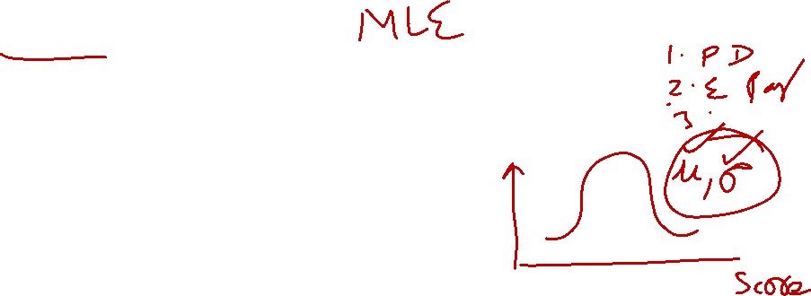
Fitting distributions
Given data x⁽¹⁾, …, x^{(n)} sampled from a “true” distribution p_{data}
Set up a model class: a set of parameterized distributions p_{θ}
Formulate a search problem over parameters
Want the loss function + search procedure to:
Work with large datasets (n is large, say millions of training examples)
Yield θ such that p_{θ} matches p_{data} — i.e. the training algorithm works. Think of the loss as a distance between distributions.
Note that the training procedure can only see the empirical data distribution, not the true data distribution: we want the model to generalize.
Notes:
“We never see the true distribution — only a finite dataset.”
What is the learning goal?
We want:
$$p_{θ}≈p_{\text{data}}$$
But we only observe:
$${\hat{p}}_{\text{data}} \text{(}\text{empirical} \text{distribution}\text{)}$$
Explain:
“The empirical distribution puts equal mass on each training example.”
Loss as a “distance between distributions”
“Training a generative model means minimizing a distance between two distributions.”
Even though:
We never write this distance explicitly
We approximate it using data
“If the model just memorizes training data, it fails.” “We want it to assign high probability to new but similar data.”

Slide 18
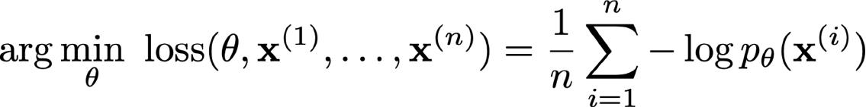
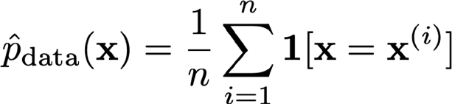

Maximum likelihood
Maximum likelihood: given a dataset x⁽¹⁾, …, x^{(n)}, find θ by solving the optimization problem
Statistics tells us that if the model family is expressive enough and if enough data is given, then solving the maximum likelihood problem will yield parameters that generate the data
Equivalent to minimizing KL divergence between the empirical data distribution and the model
Notes:
We choose parameters that make the observed data as probable as possible. Not:
“correct labels”
“minimum error”
But:
“High likelihood under the model.”
Why log?
Products of probabilities → tiny numbers
Logs turn products into sums
Easier optimization
Connection to KL divergence
“Maximizing likelihood is equivalent to minimizing how different our model distribution is from the empirical data distribution.”
“Statistics guarantees that if the model is expressive enough and data is sufficient, this works.”

Slide 19
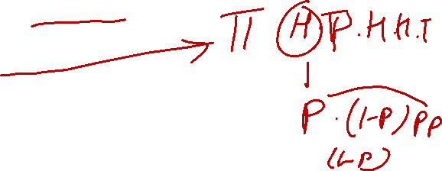
Fitting normal distribution
x = [65, 70, 72, 68, 74,69, 71]
S01: Assume its normal
S02: Estimate Params (MLE): N(U, std.dev )
Q– coin (don’t know if its fair coin..), flip 5 times: H, T, H, H, T
MLE, PROB OF GETTING HEADS ..
SO1: BINOMIAL N(H) = 3, N(T)=2, P(H) = P P(T) = 1-P
LIKELIHOOD OF OBS. DATA = (P^3).(1-P)^2
LOG LIKELIOOD = LOG ( (P)^3 . (1-P)^2 ) = LOG( (P)^3 ) + LOG( (1-P)^2 ) = 3 LOG P + 2 LOG (1-P)
DL/DP = 3/P - 2/ (1-P) ==0 ➔ 3/P = 2/(1-P) ➔ 3 – 3P = 2P ➔ P = 3/5 = 0.6

Slide 20
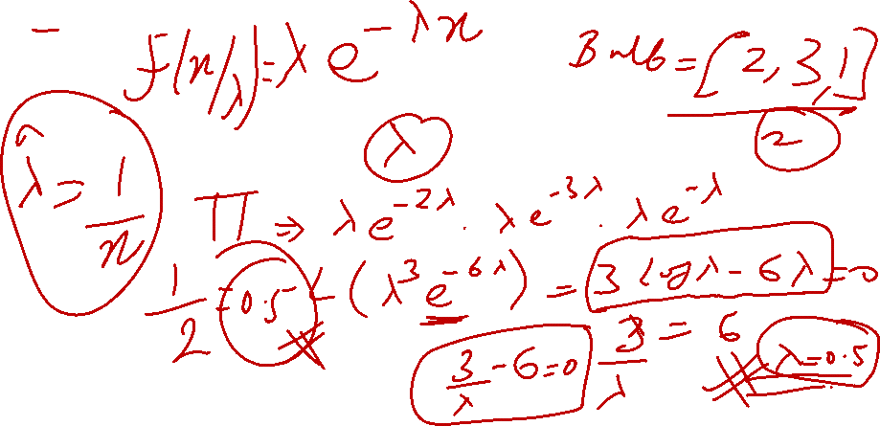

MLE – EXPONENTIAL DISTRIBUTION

Slide 21
